Slide 1
Traffic Accident Analysis
Country : India
Source: “Kaggle – India Road Accident Dataset Predictive Analysis”
Name: G.VARSHITHA Roll No.: 2211CS010699
Section:S1-91

Slide 2
Table of Contents
Introduction & Business Context
Dataset & Objectives
Methodology & Technologies
Data Processing & Feature Engineering
Visualization & Insights
Key Findings
Conclusion

Slide 3
1️⃣ Introduction & Business Context
Road traffic accidents are a major cause of injuries and fatalities in India. With millions of vehicles and diverse driving conditions, understanding accident trends is vital for improving road safety. This project uses large-scale traffic accident data to uncover key factors contributing to accidents—such as location, weather, time, and vehicle type—using Apache Spark and PySpark for distributed data analysis. The insights can help authorities design better safety policies, infrastructure planning, and awareness programs.

Slide 4
2️⃣ Dataset & Objectives
Dataset Source: Road Accidents in India — Kaggle Dataset Size: ~1.2 million records across multiple years.
Key Columns:
State / UT
Accident Date & Time
Weather Condition
Vehicle Type
Severity
Casualties
Road Type

Slide 5
Objectives:
Identify accident-prone states and regions.
Analyze the impact of time, weather, and vehicle type on accident severity.
Discover seasonal and temporal trends.
Build predictive insights to aid traffic management and prevention strategies.

Slide 6
3️⃣ Methodology & Technologies
Technologies Used:
Apache Spark (PySpark): for distributed processing of large datasets.
Python: for data handling and visualization.
Google Colab / Jupyter Notebook: for analysis environment.
Matplotlib & Seaborn: for visualization.
Pandas / Spark DataFrame: for data manipulation.

Slide 7
Methodology Steps:
Data collection and loading in PySpark.
Data cleaning and preprocessing.
Exploratory Data Analysis (EDA).
Feature engineering.
Visualization and pattern identification.
Predictive modeling and result evaluation.

Slide 8
4️⃣ Data Processing & Feature Engineering
Removed null, duplicate, and inconsistent records.
Standardized date-time and location formats.
Derived new features like:
Hour of Day
Day of Week
Month
Weather Category
Converted categorical features into numeric format using StringIndexer.
Filtered extreme outliers in casualty counts.

Slide 9
5️⃣ Visualization & Insights
Visualizations were performed to extract meaningful patterns:
State-wise Accident Heatmap: Identified high-risk states.
Accident Count by Month (Bar Chart): Seasonal trends observed.
Severity Distribution (Pie Chart): Ratio of minor vs. fatal cases.
Weather vs. Severity (Grouped Bar Chart): Rain and fog show higher fatal rates.
Vehicle Type vs. Casualty Count (Boxplot): Two-wheelers dominate accident involvement.
Time of Day vs. Frequency (Line Plot): Evening and late-night peaks detected.

Slide 10
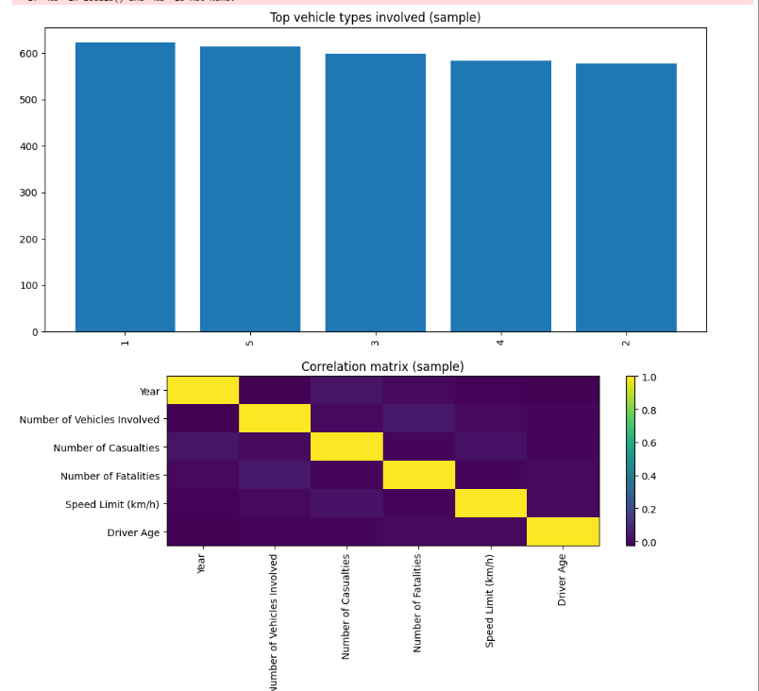

Slide 11
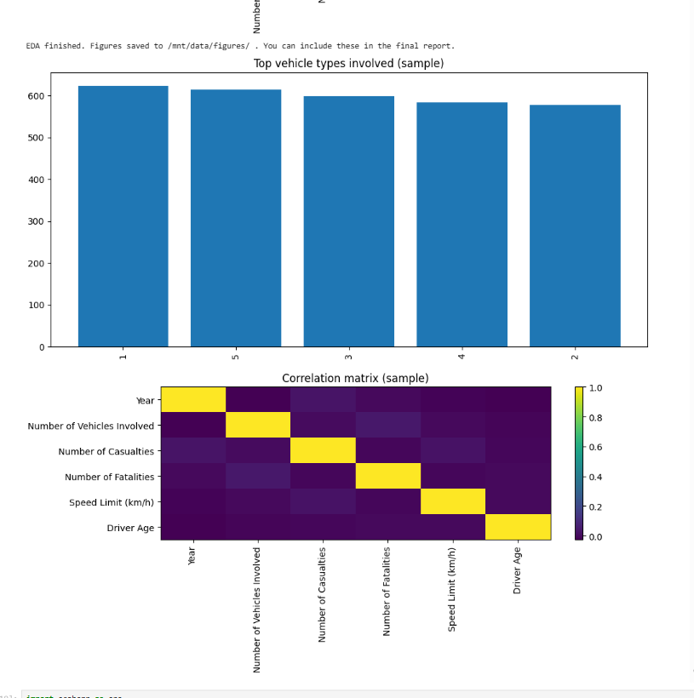

Slide 12
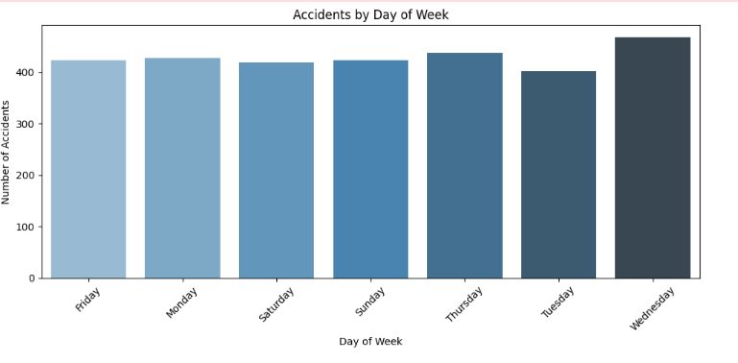
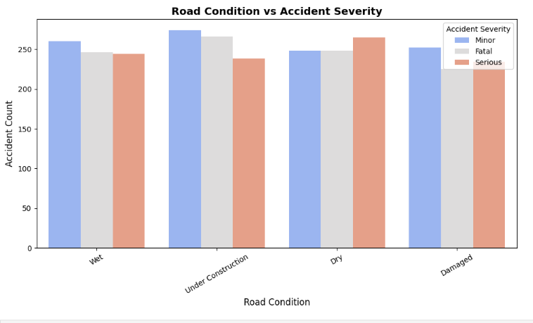
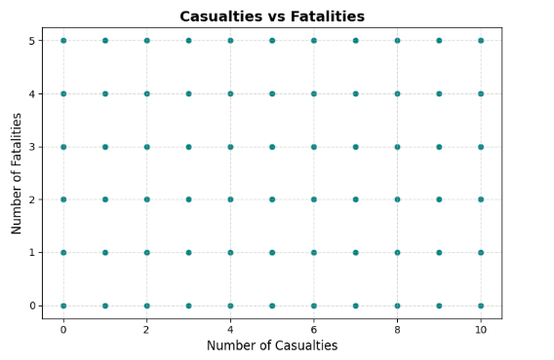
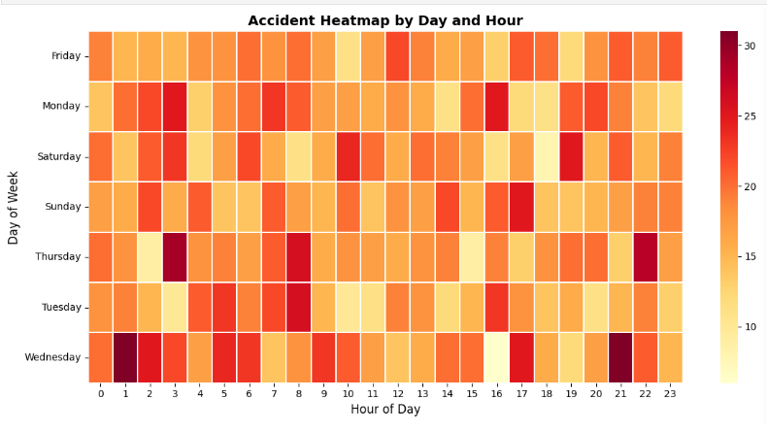

Slide 13
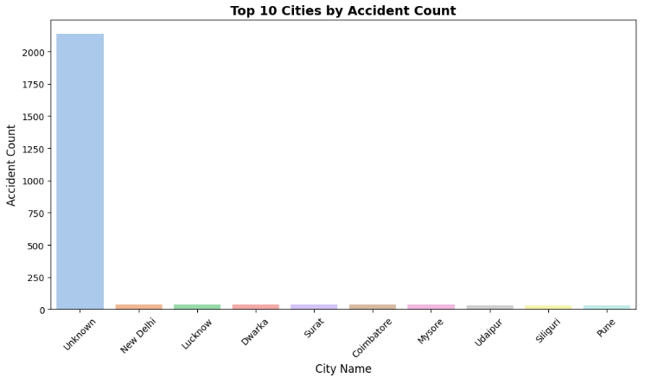
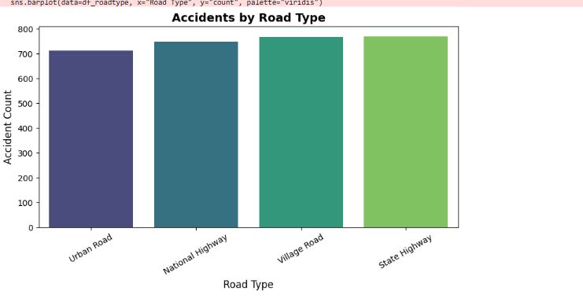
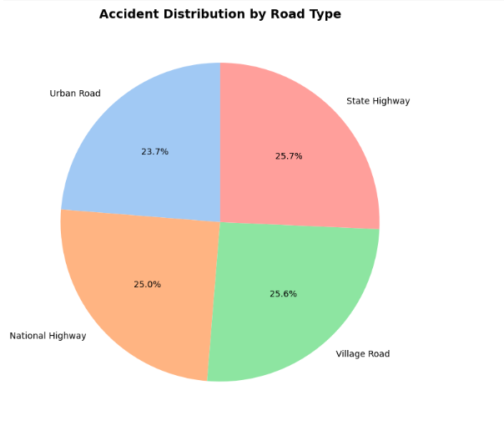
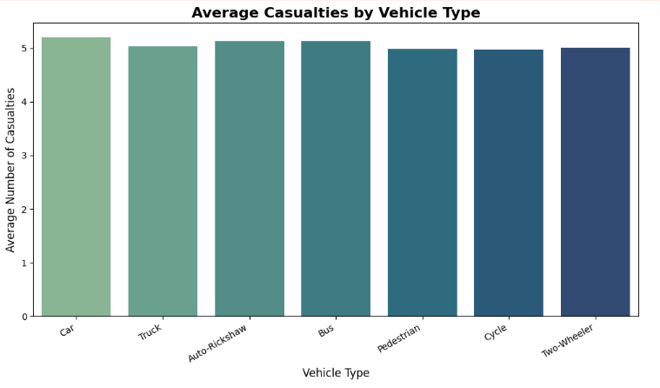

Slide 14
6️⃣Key Findings
Evening hours (6–10 PM) show the highest number of accidents.
Two-wheelers account for the majority of casualties.
Rainy weather significantly increases accident severity.
Urban states (e.g., Maharashtra, Tamil Nadu, Karnataka) lead in accident frequency.
Severity strongly correlates with speed and visibility conditions.

Slide 15
7️⃣ Conclusion
This study demonstrates the power of Big Data Analytics using PySpark for real-world safety challenges. By analyzing large-scale accident data, actionable insights can be derived to reduce accidents and fatalities. Future work can integrate real-time IoT traffic data and machine learning models for early risk prediction and alert systems.

